Slide 1
Lecture 7 – Link Layer and Enterprise Switching
COMP1002 (Cybersecurity and Networks)

Slide 2
Overview
Introduction to Link Layer
Multiple Access Protocols
LANs
Addressing and ARP
Ethernet and Switches
Switch basic configuration (CCNA2/ch1)
SVI address, SSH
Hierarchical network model
Access/distribution/core
Logical and physical topology

Slide 3

















Link Layer: Introduction
terminology:
hosts and routers: nodes
communication channels that connect adjacent nodes along communication path: links
wired links
wireless links
LANs
layer-2 packet: frame, encapsulates datagram
data-link layer has responsibility of
transferring datagram from one node
to physically adjacent node over a link

Slide 4
Link layer services
framing, link access:
encapsulate datagram into frame, adding header, trailer
channel access if shared medium
“MAC” addresses used in frame headers to identify source, destination
different from IP address!
reliable delivery between adjacent nodes
we learned how to do this already in Transport Layer
seldom used on low bit-error link (fiber, some twisted pair)
wireless links: high error rates (try to correct an error locally)
Notes:
Reliable delivery between adjacent nodes, e.g. using retransmission and acknowledgement.

Slide 5
Link layer services (more)
error detection:
errors caused by signal attenuation, noise.
receiver detects presence of errors:
signals sender for retransmission or drops frame
error correction:
receiver identifies and corrects bit error(s) without resorting to retransmission

Slide 6



Multiple access links, protocols
two types of “links”:
point-to-point
point-to-point link between Ethernet switch, host
broadcast (shared wire or medium)
old-fashioned Ethernet
802.11 wireless LAN
shared wire (e.g.,
cabled Ethernet)
shared RF
(e.g., 802.11 WiFi)
shared RF
(satellite)
humans at a
cocktail party
(shared air, acoustical)

Slide 7
Multiple access protocols
single shared broadcast channel
two or more simultaneous transmissions by nodes: interference
collision if node receives two or more signals at the same time
multiple access protocol
distributed algorithm that determines how nodes share channel, i.e., determine when node can transmit
communication about channel sharing must use channel itself!
no out-of-band channel for coordination

Slide 8
Random access protocols
when node has packet to send
transmit at full channel data rate R.
no a priori coordination among nodes
two or more transmitting nodes ➜ “collision”,
random access MAC protocol specifies:
how to detect collisions
how to recover from collisions (e.g., via delayed retransmissions)
Random access MAC protocols:
Carrier Sense Multiple Access (CSMA)

Slide 9
MAC operation - CSMA
Carrier Sense
If signal detected – wait
If no signal detected – transmit while continuing to listen for traffic/colisions
When finished, return to listening mode.
Multi-access
Two devices can start transmitting at the same time
When they encounter each other, the signals mix and the message is destroyed.

Slide 10
MAC operation – CA or CD
Monitor media for data signal presence
CSMA/Collision Detection
If no data signal - media is free, transmit data.
If data signal – media busy, try later
Ethernet
CSMA/Collision Avoidance
If no data signal - media is free, transmit notification across the media of its intent to use it, then send data.
802.11 wireless

Slide 11
MAC addresses and ARP
32-bit IP address:
network-layer address for interface
used for layer 3 (network layer) forwarding
MAC (or LAN or physical or Ethernet) address:
function: used ‘locally” to get frame from one interface to another physically-connected interface
48 bit MAC address (for most LANs) burned in NIC ROM
e.g.: 1A-2F-BB-76-09-AD
hexadecimal (base 16) notation
(each “numeral” represents 4 bits
e.g. A – 1010; B – 1011; F - 1111)
MAC address: hardwired
IP address: allocated

Slide 12

LAN addresses and ARP
each adapter on LAN has unique LAN address
1A-2F-BB-76-09-AD
LAN
(wired or
wireless)
adapter
71-65-F7-2B-08-53
58-23-D7-FA-20-B0
0C-C4-11-6F-E3-98

Slide 13
LAN addresses (more)
MAC address allocation administered by IEEE
MAC: 48 bits, e.g., B4-96-91-76-09-AD
first 24 bits, OUI, Organizationally Unique Identifier (e.g., B4-96-91 Intel Cor)
Remaining 24 bits, NIC Specific
MAC flat address ➜ portability
can move LAN card from one LAN to another
IP hierarchical address not portable
address depends on IP subnet to which node is attached
Notes:
B4-96-91 Intel Corporate

Slide 14


ARP: address resolution protocol
Question: how to determine
interface’s MAC address, knowing its IP address?
ARP table: each IP node (host, router) on LAN has table
IP/MAC address mappings for some LAN nodes:
< IP address; MAC address; TTL>
TTL (Time To Live): time after which address mapping will be forgotten (typically 20 min)
137.196.7.78
1A-2F-BB-76-09-AD
137.196.7.23
137.196.7.14
LAN
71-65-F7-2B-08-53
58-23-D7-FA-20-B0
0C-C4-11-6F-E3-98
137.196.7.88
Notes:
e.g. under windows, open a command window, type ‘arp -a’ (no quote), you see a list of IP address, MAC address TTL list (or the latest ARP table).

Slide 15
ARP Protocol
A wants to send datagram to B
B’s MAC address not in A’s ARP table.
A broadcasts ARP query packet, containing B's IP address
destination MAC address = FF-FF-FF-FF-FF-FF
all nodes on LAN receive ARP query
B receives ARP packet, replies to A with its (B's) MAC address
frame sent to A’s MAC address (unicast)
A caches (saves) IP-to-MAC address pair in its ARP table until information becomes old (times out)
soft state: information that times out (goes away) unless refreshed
ARP is “plug-and-play”:
nodes create their ARP tables without intervention from net administrator

Slide 16
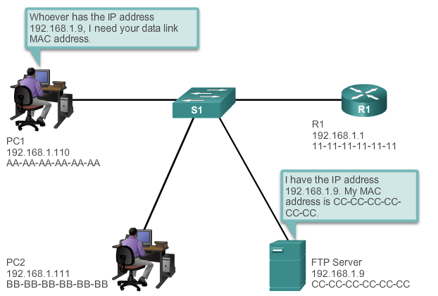
Address Resolution Protocol (ARP)
Linking IP and hardware addresses

Slide 17
Quiz 1
A staff has moved her computer from an office in SMB Building to an office in PSQ Building in the campus. It is known that PCs in SMB and PSQ are in different subnets. Regarding the MAC and IP addresses of the computer before and after the move, which of the following is correct?
Both IP and MAC addresses have changed.
Only IP address has changed.
Only MAC address has changed.
Both IP and MAC addresses are the same as before.
Notes:
The correct answer is b). Only IP address has changed when the PC is moved from SMB to PSQ. The PC’s MAC address will not change.

Slide 18
Ethernet
“dominant” wired LAN technology:
single chip, multiple speeds (e.g., Broadcom BCM5761)
first widely used LAN technology
simpler, cheap
kept up with speed race: 10 Mbps – 10 Gbps

Slide 19
Ethernet frame structure
sending adapter encapsulates IP datagram (or other network layer protocol packet) in Ethernet frame
preamble:
7 bytes with pattern 10101010 followed by one byte with pattern 10101011
used to synchronize receiver, sender clock rates
type
preamble
dest.
address
source
address
data (payload)
CRC
Notes:
Preamble: 10101010 10101010 10101010 10101010 10101010 10101010 10101010 10101011 (the last two ‘1’ in the 8th byte alert Adapter B that the “important stuff” is about to come.

Slide 20
Ethernet frame structure (more)
addresses: 6 byte source, destination MAC addresses
if adapter receives frame with matching destination address, or with broadcast address (e.g., ARP packet), it passes data in frame to network layer protocol
otherwise, adapter discards frame
type: indicates higher layer protocol (mostly IP but others possible, e.g., Novell IPX, AppleTalk)
CRC: cyclic redundancy check at receiver
error detected: frame is dropped
type
preamble
dest.
address
source
address
data (payload)
CRC

Slide 21
802.3 Ethernet standards: link & physical layers
many different Ethernet standards
common MAC protocol and frame format
different speeds: 2 Mbps, 10 Mbps, 100 Mbps, 1Gbps, 10 Gbps, 40 Gbps
different physical layer media: fiber, cable
application
transport
network
link
physical
MAC protocol
and frame format
100BASE-TX
100BASE-T2
100BASE-FX
100BASE-T4
100BASE-SX
100BASE-BX
copper (twister
pair) physical layer
fiber physical layer
Notes:
‘T’ refers to twisted-pair copper wires. ‘F’ for fiber.

Slide 22
Switches
Segmentation of networks into separate collision domains
Dedicated Bandwidth
Collision-free environment
Full-duplex operation
Selective forwarding
Based on the destination MAC
Table containing pairs of learned MAC addresses and their corresponding ports for forwarding

Slide 23
Switch states
Learning – records (MAC_addr, port) pairs using the source MAC address in frames
If entry exists for a (port, sourceMAC) pair – update aging timer (see below)
If no entry exists – write pair into table
Aging – remove the learned MACs from table after a certain time if not updated by newer frames
Flooding – if no entry for destMAC, send frame to all ports except the arrival one
Filtering – drop CRC failures, impose security

Slide 24
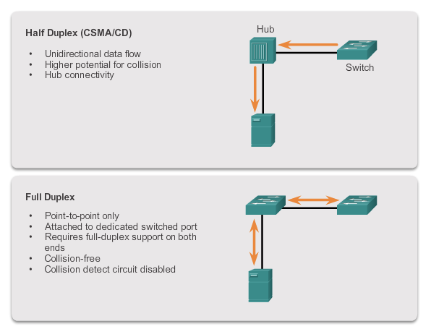
Half/Full duplex

Slide 25

Switch: multiple simultaneous transmissions
hosts have dedicated, direct connection to switch
switches buffer packets
Ethernet protocol used on each incoming link, but no collisions; full duplex
each link is its own collision domain
switching: A-to-A’ and B-to-B’ can transmit simultaneously, without collisions
A
C’
B
6
1
2
5
4
3
B’
C
A’
switch with six interfaces
(1,2,3,4,5,6)

Slide 26
Switch forwarding table
Q: how does switch know A’ reachable via interface 4, B’ reachable via interface 5?
A
C’
B
A: each switch has a switch table, each entry:
(MAC address of host, interface to reach host, time stamp)
looks like a routing table!
6
1
2
5
4
3
B’
C
A’
Q: how are entries created, maintained in switch table?
something like a routing protocol?
switch with six interfaces
(1,2,3,4,5,6)

Slide 27
Switch: self-learning
Source: A
Dest: A’
switch learns which hosts can be reached through which interfaces
when frame received, switch “learns” location of sender: incoming LAN segment
records sender/location pair in switch table
A
A A’
C’
B
6
1
2
5
4
3
B’
C
A’
MAC addr interface TTL
A
1
60
Switch table
(initially empty)

Slide 28
Self-learning, forwarding: example
Source: A
Dest: A’
A
A A’
frame destination, A’, location unknown:
flood
C’
B
destination A location known:
6
1
2
A A’
A A’
A A’
A A’
selectively send
on just one link
A A’
5
4
3
B’
C
A’ A
A’
MAC addr interface TTL
A
1
60
switch table
(initially empty)
A’
4
60

Slide 29
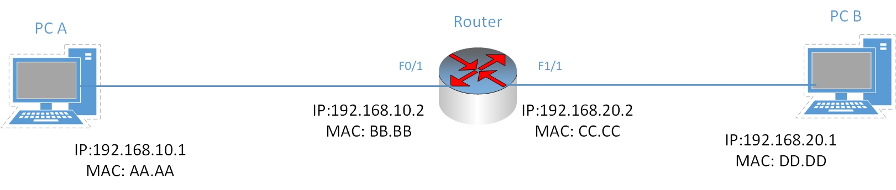
Quiz 2
In the above diagram with known IP address and MAC address on each interface (the MAC address is shortened for demo purpose). A packet is sent from PC A with destination address of 192.168.20.1 (PC B). The packet is encapsulated in an Ethernet frame. What is the Destination MAC address in the frame?
AA.AA
BB.BB
CC.CC
DD.DD
Notes:
The correct answer is b).
The Destination MAC address in the frame is just the MAC address at the other end of the link, which is the MAC address of the Router interface F0/1.

Slide 30
Remote management of a switch
Preparing for remote management of a switch
Configure via console port
Switch requires an IP address
Assigned to the Switch Virtual Interface (SVI)
SVI – associated with a VLAN
VLAN - logical groups to which ports can be assigned
SVI - not used for routing packets
Default
VLAN 1 – including all the ports

Slide 31
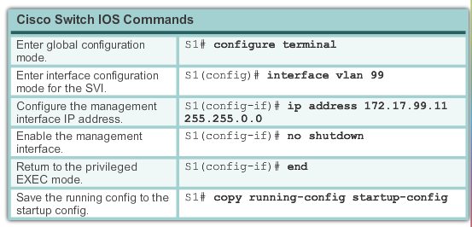
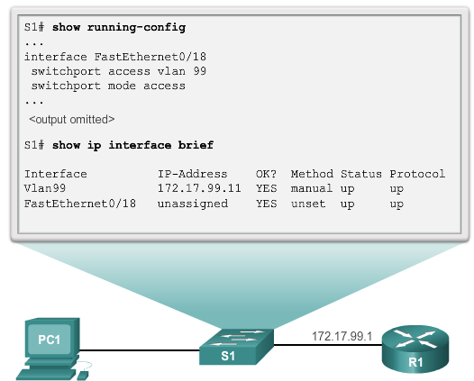
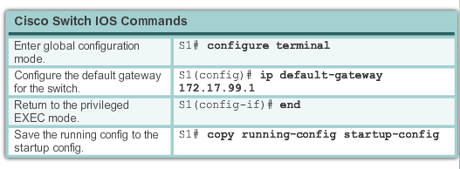
Configuration steps

Slide 32
Secure remote access
Always use SSH (Secure Shell) to remotely access a switch
telnet – username and password sent in cleartext
SSH supported by “K9” IOS versions
Look for K9 in the filename of the IOS (e.g. c2960-lanbaseK9)

Slide 33
Configure SSH
Verify SSH support.
show ip ssh - verify that the switch supports SSH.
If IOS has no cryptographic features, command is unrecognized.
Configure the IP domain.
ip domain-name domain-name
Generate RSA key pairs.
automatically enables SSH.
crypto key generate rsa to enable the SSH server on the switch and generate an RSA key pair.
crypto key zeroize rsa deletes the RSA key pair.
After the RSA key pair is deleted, the SSH server is automatically disabled.

Slide 34
Configure SSH
Configure user authentication.
locally or using an authentication server.
Local - create a username and password pair
username username password password
Configure the vty lines.
Enable the SSH protocol on the vty
transport input ssh
Require local authentication for SSH connections from the local username database.
line vty
login local

Slide 35
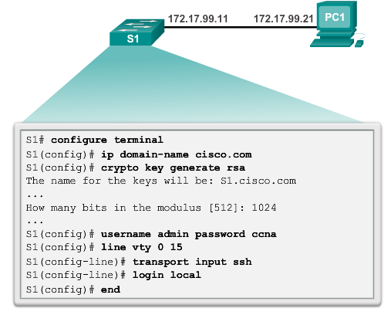
Configure SSH

Slide 36
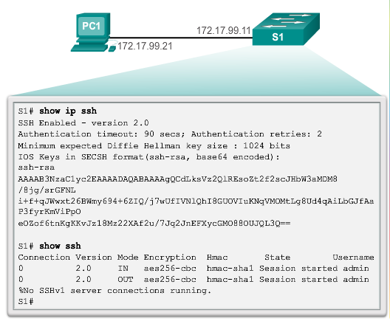
Verify SSH

Slide 37
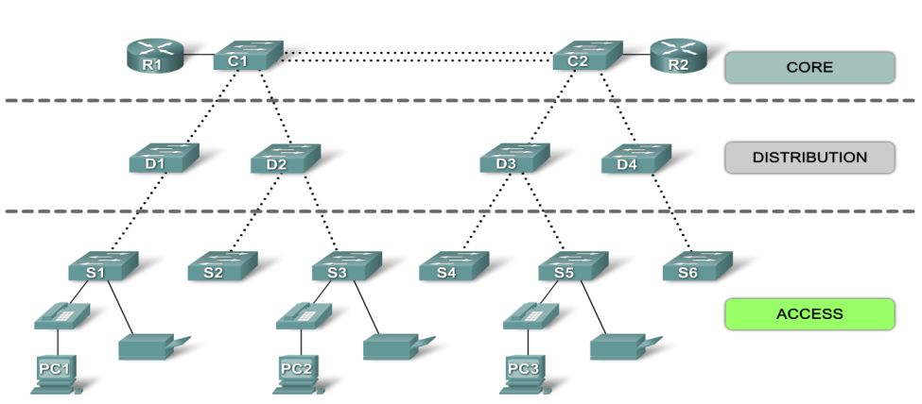
Hierarchical Network Model
More likely to be successful if a hierarchical design model is used when building a LAN that satisfies the needs of a small or medium-sized business.
Hierarchical network design divides the network into discrete layers – usually 3: access, distribution, core (backbone)
Each layer provides specific functions that define its role within the overall network.
Separating the network functions provides a modular design
which facilitates scalability and performance.
Notes:
37
Use graphic 1.1.1.1
Use graphic 1.1.1.3

Slide 38
Access Layer
Aim: connect devices to the network and control which are allowed to communicate on the network.
Interfaces with end devices (PCs, printers, and IP phones)
Provides access to the rest of the network.
Can include routers, switches, bridges, hubs, and wireless access points.
Notes:
38
Use graphic 1.1.1.1
Use graphic 1.1.1.3

Slide 39
Distribution Layer
Aim: aggregate data from access layer before it is transmitted to core layer for routing to its destination.
Distribution layer switches - high-performance devices with high availability & redundancy to ensure reliability.
Functions:
Aggregating large-scale wiring closet networks
Aggregating Layer 2 broadcast domains and Layer 3 routing boundaries
Intelligent switching, routing, and network access policy functions to access the rest of the network
High availability through redundant distribution layer switches to the end-user and equal cost paths to the core
Differentiated services to various classes of service applications at the edge of network
Notes:
39
Use graphic 1.1.1.1
Use graphic 1.1.1.3

Slide 40
Core Layer
Aggregates traffic from the distribution layer devices
Must forward large amounts of data quickly.
The high-speed backbone of the internetwork.
Critical for interconnectivity of distribution layer devices
Must be highly available and redundant.
Can also connect to Internet resources.
Smaller networks use a collapsed core model
Distribution layer and core layer are combined into one
Notes:
40
Use graphic 1.1.1.1
Use graphic 1.1.1.3

Slide 41
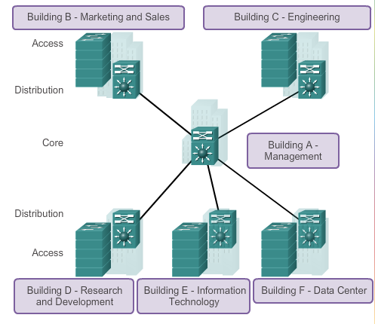
Campus network topology

Slide 42
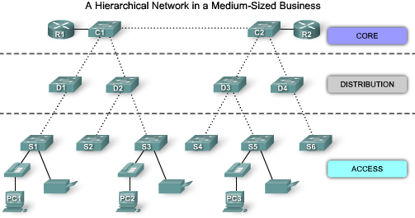
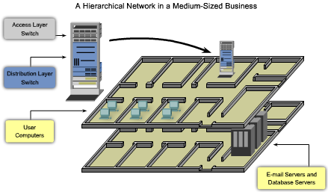
Logical Layout
The access, distribution, and core layers are separated into a well-defined hierarchy.
Easy to see which switches perform which function.
It is much harder to see these hierarchical layers when the network is installed in a business.

Slide 43
Physical Layout
User computers and network devices that need network access may be on one floor.
Email/database servers, may be on another floor.
Access layer and distribution switches – in wiring closets of each floor
Connected to each of the devices needing network access.
The access switches and distribution switch are stacked one on top of each other in the wiring closet.

Slide 44
Labs
1.3.6 – Configure SSH (CCNA2)

